Slide 1
计算机组成与设计 习题选讲
信电学院信通所 孙佳科
22131087@zju.edu.cn
18888923044
浙江大学玉泉校区信电楼308室

Slide 2
HW8
Problem1
Cache is important to providing a high-performance memory hierarchy to processors. Below is a list of 32-bit memory address references, given as word address.
3, 180, 43, 2, 181, 88, 164, 180, 89.
a) For each of these references, identify the binary address, the tag, and the index given a direct-mapped cache with 8 two-word blocks. Also list if each reference is a hit or a miss, assuming the cache is initially empty.
index has 4 bits. offset has 2 bits.
1 word = 4 bytes
Word address *4 = byte address = word address 00

Slide 3
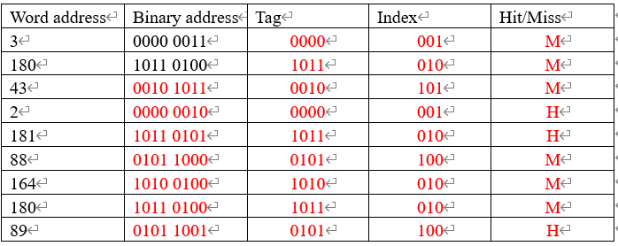
HW8
Problem1
a) For each of these references, identify the binary address, the tag, and the index given a direct-mapped cache with 8 two-word blocks. Also list if each reference is a hit or a miss, assuming the cache is initially empty.
index has 3 bits. offset has 3 bits.
Tag index offset
Word address: 3 binary address: 0000 0011 byte address: 0000 001 100

Slide 4
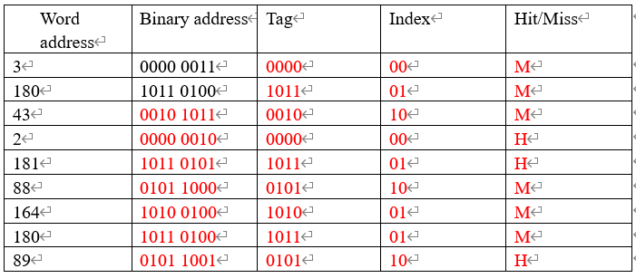
HW8
Problem1
b) For each of these references, identify the binary address, the tag, and the index given a direct-mapped cache with four-word blocks and a total size if 4 blocks. Also list if each reference is a hit or a miss, assuming the cache is initially empty.
index has 2 bits. offset has 4 bits.
Tag index offset
Word address: 3 binary address: 0000 0011 byte address: 0000 00 1100

Slide 5
HW8
Problem2
This exercise examines the impact of cache designs. For this exercise, the table of word address streams is shown in below.
1, 134, 212, 1, 135, 213, 162, 161, 2, 44, 41, 221
What is the miss rate for a fully associative cache with two-word blocks and a total size of 8 words, using LRU replacement? (LRU, Least recently use)
8 / 2 = 4 blocks
Binary address
1: 0000 000 100
134: 1000 011 000
212: 1101 010 000
1: 0000 000 100
135: 1000 011 100
Tag | Hit/Miss
0000 000
1000 011
1101 010
Offset 3bits
M
M
M
H
H
Miss rate = 9/12 = 75%

Slide 6
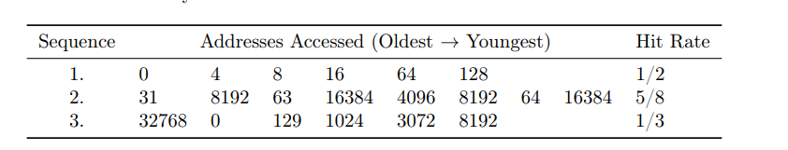
HW8
Problem3
You are trying to reverse-engineer the characteristics of a cache in a system, so that you can design a more efficient, machine-specific implementation of an algorithm you are working on. To do so, you have come up with three patterns that access various bytes in the system in an attempt to determine the following four cache characteristics:
• Cache block size (8, 16, 32, 64, or 128 B)
• Cache associativity (1-, 2-, 4-, or 8-way)
• Cache size (4 or 8 KB)
• Cache replacement policy (LRU or FIFO)
However, the only statistic that you can collect on this system is cache hit rate after performing the
access pattern. Here is what you observe (the address is in bytes):

Slide 7
HW8
Problem3
Assume that the cache is initially empty at the beginning of the first sequence, but not at the beginning of the second and third sequences. The sequences are executed back-to-back, i.e., no other accesses take place between the three sequences. Thus, at the beginning of the second (third) sequence, the contents are the same as at the end of the first (second) sequence.
Based on what you observe, what are the following characteristics of the cache? Explain the reason.
Cache block size (8, 16, 32, 64, or 128 B)?
Cache associativity (1-, 2-, 4-, or 8-way)?
Cache size (4 or 8 KB)?
Cache replacement policy (LRU or FIFO)?

Slide 8
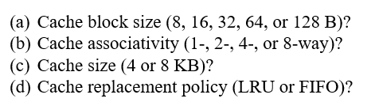
HW8
Cache block size (8, 16, 32, 64, or 128 B)?
8192 = 2^13 , 64 = 2^6, 16384 = 2^14, 4096=2^12,
32768=2^15, 3072=3*2^10
Cache: hit rate is 1/2 in sequence 1. This means that there are 3 hits, which are necessarily in addresses 4, 8 and 16. Thus, cache block size might be 32 or 64B.
In sequence 2, there are only three misses, which are in addresses 8192, 16384, and
4096. The remaining 5 accesses are hits. For 63 to be a hit, the cache block size
should be 64 B.

Slide 9
HW8
(b) Cache associativity (1-, 2-, 4-, or 8-way)? 8192 = 2^13 , 64 = 2^6,
cache size 最大为 8KB, index bits 最多为 7 位。 16384 = 2^14, 4096=2^12,
32768=2^15, 3072=3*2^10
b) 4 –way. The cache block size is 64B. Thus there are 6 offset bits.
If 1-way, 63 would miss, since 8192 would map to the same set regardless of cache size
(i.e.., bits 6 to 12 are equal).
index 部分相同为0 index bits最多6位
Address 0, 4096, 8192, 16384, and 32768 map to the same set. If 2-way, the send access to 8192 and 16384 (in sequence 2) would not hit.
index bits 最多4位 1024 = 2^10 3072=3*2^10
If 8-way, 1024 and 3072 would map to the same set as 0, 4096, 8192, 16384, and 32768, since they all share bits 6 to 9. In that case, 0 and 8192 would hits in sequence 3. That is not possible because there are only 2 hits in sequence3. 32768, 1024, and 3072 are compulsory misses, while 129 is a hit (address 128 was access by sequence 1). Thus, either 0 or 8192 should miss in sequence 3.
Index指定set

Slide 10
HW8
(c) Cache size (4 or 8 KB)?
block size 64 B offset占6bit offset [5:0]
4-way 8KB index bits 是6~10位 0， 8192， 16384， 4096，32768的第6~11位相同。
4-way 4KB index bits 是6~9位 1024,3072的第6~10位也和上面相同。
c) The cache is 4 –way associative. The access to address 0 in sequence 3 is a miss, because the cache block replaced by address 32768. Thus, access to 8192 should be a hit.
If 4-way and 4 KB, 1024 and 3072 would map to the same set as 8192. In that case, 8192 would miss.
So the size of the cache should be 8KB.

Slide 11
HW8
(d) Cache replacement policy (LRU or FIFO)?
d) For 8192 to hit in sequence 3, 4096 should have been replaced by 0. So the replacement policy is LRU, because FIFO would have replaced 8192.

Slide 12
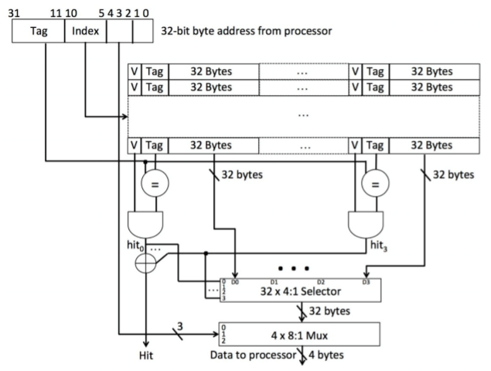
HW9
Problem2
You are given the sketch of a cache design below:
Note: a 4:1 Selector has four control inputs labeled 0, 1, 2, 3 and four data inputs D0, D1, D2, D3. It connects Di to the output when the hit control signal is true. Assume that at most one control input is true at any time. The selector function is undefined when none of the control inputs are true.
Answer the following questions about the cache above.

Slide 13
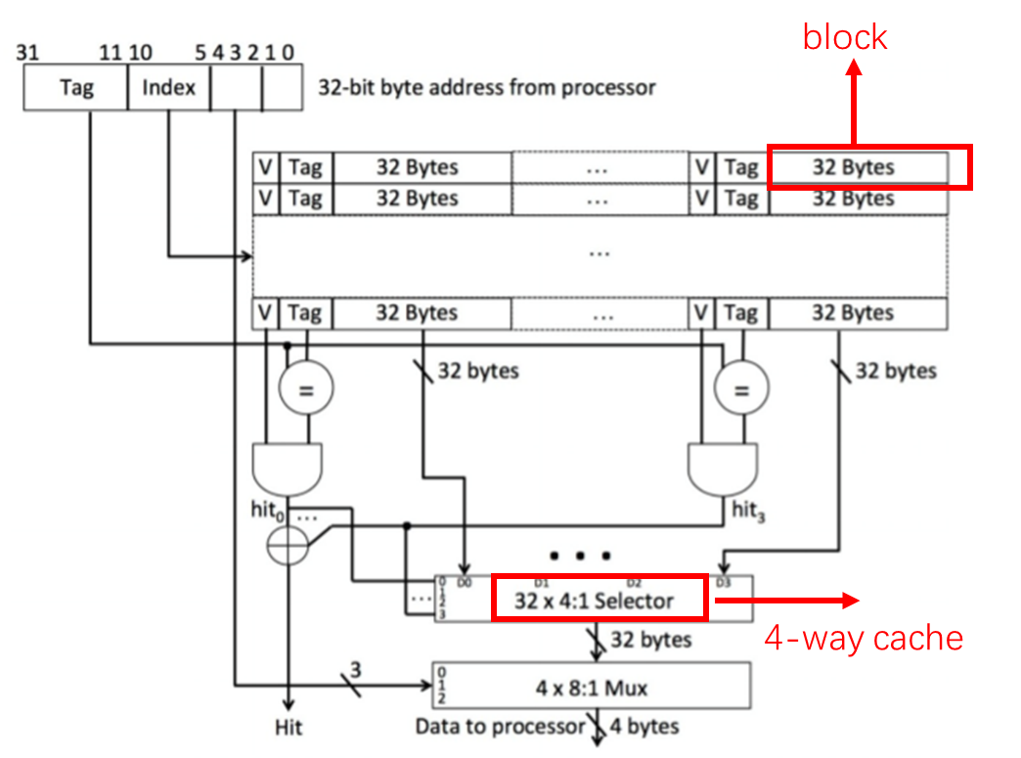
HW9
a) What is the block size of the cache in bytes?
32 Bytes
b) What is the number of blocks in this cache?
blocks 32 bytes, offset 5bits (4~0bit)
index 10~5 bit, index has 6bits.
the cache has 2^6 = 64 entries , each entry has 4 blocks (4-way cahce)
The number of blocks is 64 * 4 = 256
c) What is the total data capacity of the cache in bytes?
data capacity = blocks number * blocks size
256 * 32 = 8192 bytes.

Slide 14

HW9
d) What is the associativity of the cache?
4:1 selector 4-way
e) Is this a write-through or write-back cache?
write-through
There is no dirty bit, so it is a write-through cache.
f) What is the total number of valid bits in the cache?
256
There are 256 blocks, and each block needs 1 valid bit. Thus there are 256 valid bits.
g) What is the total number of tag bits in the cache?
5376
Each tag needs 21 bits, and each block needs one tag. Thus the tag bits in the cache is
256 * 21 = 5376

Slide 15
HW9
Problem2
Caches are important to providing a high performance memory hierarchy to process. Below is a list of 32bit memory address references, given as word address.
7, 215, 175, 215, 7, 84, 65, 174, 64, 105, 85, 215
You’re asked to optimize a cache design for the given references. There are three direct-mapped cache designs possible, all with total of 8 words of data:
C1 has 1-word blocks, C2 has 2-word blocks, and C3 has 4-word blocks.
In term of miss rate, which cache design is the best?
If the miss stall time is 25 cycles, and C1 has an access time of 2 cycles, C2 takes 3 cycles, and C3 takes 5 cycles, which is the best cache design?

Slide 16
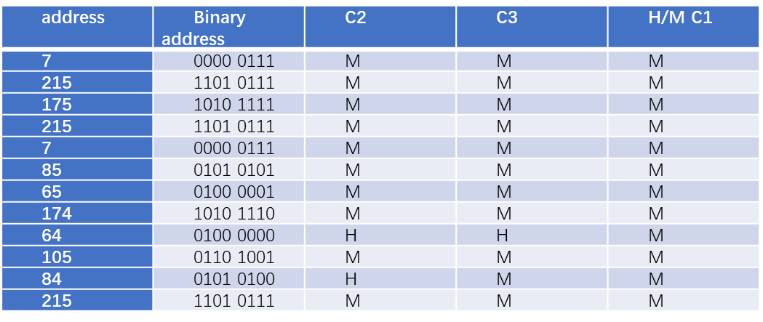
HW9
解：因为总共有 8words数据，那么：
C1：8words/1word=8 blocks C2：8words/2word=4 blocks C3：8words/4word=2 blocks
根据直接映射方式，可以得到三个cache的命中次数，当Hit的时候时间是access时间, 当miss的时候，会引起阻塞时间25 cycles，所以：
总时间 = Hit rate* Hit time + Miss rate*(Hit time + Stall time)
= (Hit rate + Miss rate)*Hit time + Miss rate * Stall time = Hit time + Miss rate*Stall time
C1：0hit，stall time=25*12+2*12=324 cycles
C2：2hit，stall time=25*10+3*12=286 cycles
C3：1hit，stall time=25*11+5*12=335 cycles
C2 best

Slide 17
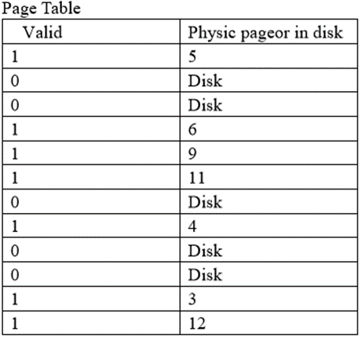
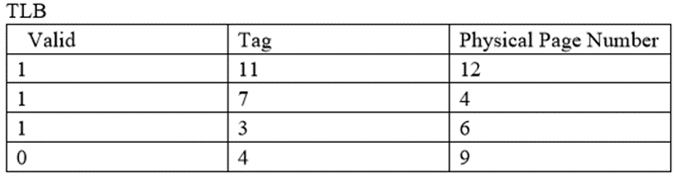
HW10
Problem2
Virtual memory uses a page table to track the mapping of virtual addresses to physical addresses. This exercise shows how this table must be updated as addresses are accessed. The following table is a stream of virtual addresses as seen on a system. Assume 4 KB pages, a 4-entry fully associative TLB, and true LRU replacement. If pages must be brought in from disk, increment the next largest page number.
9452, 30954, 19136, 46502, 38110, 16653, 48480
第0行
第2行
根据 TLB中tag确定page table 行，如tag = 0, 则是page table 第0行，PPN=5。 Tag=1，是page table第1行， PPN = disk.
第11行

Slide 18
HW10
Problem2
1.1 Given the address stream in the table, and the initial TLB and page table states shown above, show the final state of the system. Also list for each reference if it is a hit in the TLB, a hit in the page table, or a page fault
VPN
Tag | index
解：因为每一个page是4KB，即2^12bytes，所以低12bits就是页内偏移地址(page offset)，其余高位即为虚页号(virtual page number VPN)：
因为TLB是fully associative TLB，没有index，只有tag。将地址的虚页号VPN和TLB的tag进行匹配，若匹配，则是一次TLB Hit，并且更新一次LRU。
若TLB中没有匹配的项，则继续检查页表，并用虚页号VPN作为页表索引，如果当前entry在页表中的有效位为1，则发生TLB Miss，并采用LRU策略，用这次地址转换来更新TLB，并将TLB有效位置1。
若页表中的有效位为0，则页在磁盘上，发生一次缺页，将新的页号（题中为下一个可能的最大页号，即13开始）加入到页表中，并将页表的有效位置1，然后对TLB进行更新

Slide 19
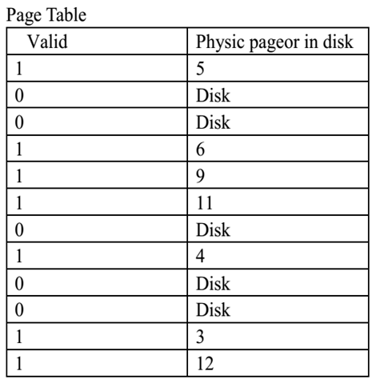

HW10
Problem2
1) 对于地址流中的第一个地址2 4EC，tag为2，先查看TLB，TLB中缺失；再查看page，page table第三行的valid为0，即发生一次缺页，将新的页号D（相对12而言，13是下一个可能的最大页号）加入page table中，更新page table，并置有效位为1；并用 2->D转换 更新TLB，采用LRU策略，TLB第四行valid= 0，将TLB的第四行进行更新。
1
13
1
2
13
(1)
十六进制表示：
9452 = 0x24EC 16653 = 0x410D
30954 = 0x78F4 48480 = 0xBD60
19136 = 0x 4AC0
46502 = 0x B5A6
38110 = 0x 94DE

Slide 20
HW10
(2) 对于地址流中的第二个地址7 8F4, Hit in TLB
(3) 对于地址流中的第三个地址4 AC0 ，tag为4，先查看TLB，TLB中缺失；再查看page，page table第5行的valid为1，所以只发生一次TLB缺失；用4->9转换更新TLB，采用LRU策略，将TLB的第1行进行更新。
(4)对于地址流中的第四个地址B 5A6，同样只是发生一次Miss in TLB，
Page table 的第12行valid = 1,用11(B)->12更新TLB，采用LRU策略，更新TLB第3行。
(1)
1
13
4
9
(1)
1
2
13
(1)
4
9
(1)
(1)
11
12
1
2
13
(1)

Slide 21
HW10
(5) 对于地址流中的第5个地址9 4DE ，tag为9，先查看TLB，TLB中缺失；再查看page，page table第10行的valid为0，所以发生一次缺页；将新的页号E（相对13而言，14是下一个可能的最大页号）加入page table中，更新page table用9—>14转换更新TLB，采用LRU策略，将TLB的第4行进行更新
(6)对于地址流中的第6个地址4 10D， Hit in TLB
(7)对于地址流中的第7个地址B D60， Hit in TLB
4
9
(1)
(1)
1
13
11
12
(1)
9
14
1
2
13
(1+1)
1
14

Slide 22
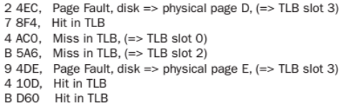
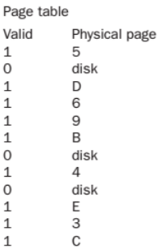
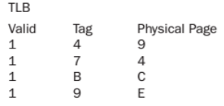
HW10
所以最终的状态为：

Slide 23
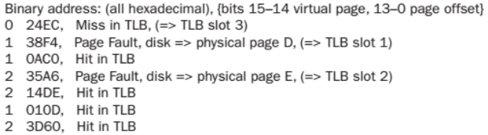
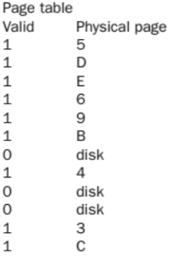
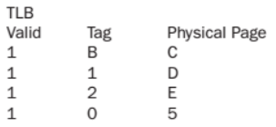
HW10
1.2 Repeat Exercise 1.1, but this time use 16 KB pages instead of 4 KB pages. What would be some of the advantages of having a larger page size? What are some of the disadvantages?
解 :page大小从4KB变成了16KB，则偏移地址从12位变成了14位，由(1)可知bits15~14为虚页号，bits13~0为偏移地址，其他的过程和(1)类似，最终的状态为
是用原来的tag索引在page table中查找
0)
1)
优点：大的page size使得一个page中可以存储更多的地址，这样一来可以减少从磁盘读取页的次数
缺点：大的page size也意味存储空间增大，因此在传输时间可能更长
1
D
2
E
3
6

Slide 24
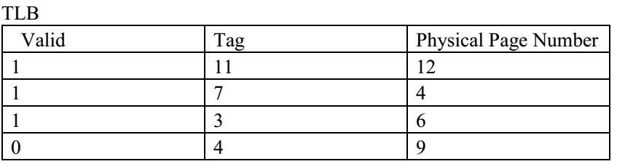
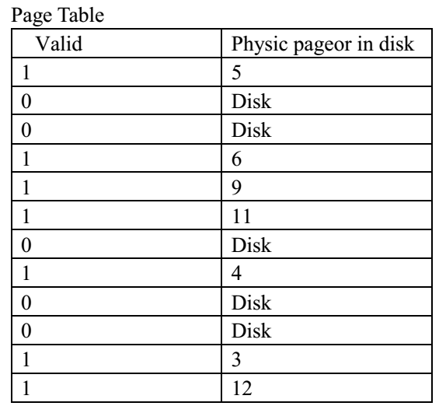
HW10
1.3 Show the final contents of the TLB if it is 2-way set associative. Also show the contents of the TLB if it is direct mapped. Discuss the importance of having a TLB to high performance. How would virtual memory accesses be handled if there were no TLB? There are several parameters that impact the overall size of the page table.
解：考虑TLB采用2路组相联方式，同样低12位bits 11~0为page offset
set0
set1
(1)对于地址流中的第一个地址2 4EC，因为
Vitural Page number为2，TLB index=0，对应组0，TLB Tag=1，首先看TLB，在TLB中缺失；
然后看page，page中的第3行Valid 为0，
因此发生一次缺页；将新的页号D
（相对12而言，13是下一个可能的最大页号）
加入page table中，更新page table，并置
有效位为1，更新TLB的组0(set0)的第2行：2->D

Slide 25
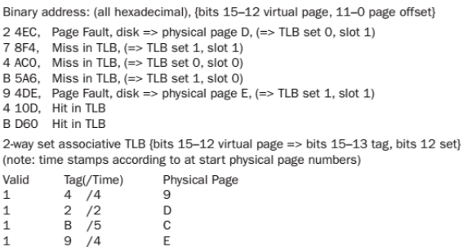
HW10
2路组相联方式最终状态：

Slide 26
HW10
解：考虑TLB采用直接映射，同样低12位bits 11~0为page offset
对于直接映射，虚拟地址中的虚页号通过
mod 4取余来确定对应TLB中的索引
(1)对于地址流中的第一个地址2 4EC，因为
Page number(tag) 为2, 对应TLB中的第3行，由表
可知在TLB中缺失；然后看page table，
Page table中的第3行Valid 为0，因此发生一次
缺页；将新的页号D（相对12而言，13是下一
个可能的最大页号）加入page table中，
更新page table，并置有效位为1，
更新TLB的组0的第3行：2->D

Slide 27
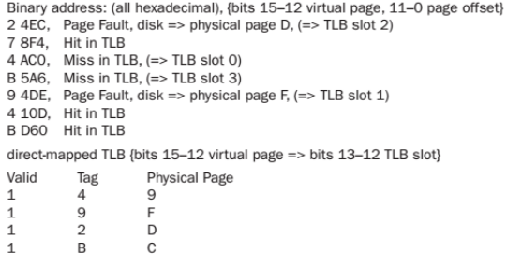
HW10
直接映射方式下的最终状态：
TLB在避免将虚拟地址转换成物理地址过程中对主存高时间代价的访问方面具有重要的作用，尤其当主存访问频繁的时候更是如此。若没有TLB，每一次访问时，必须通过虚拟地址来使用页表，速度慢。

Slide 28
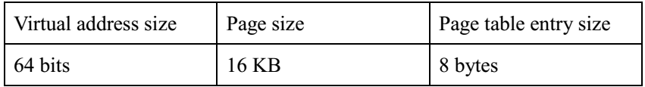
HW10
There are several parameters that impact the overall size of the page table. Listed below are several key page table parameters
1.4 Given the parameters in the table above, calculate the total page table size for a system running 5 applications that utilize half of the memory available.
解：因为虚拟地址为64bits，而page size是16KB，即offset是14 bits：
64-14=50；所以page的entry有2^50，因为每个page table entry size有8bytes，每一个entry page table 大小为2^53 bytes
Total for 5 application=5*2^53/2=5*2^52bytes

Slide 29
HW10
1.5 Given the parameters in the table above, calculate the total page table size for a system running 5 applications that utilize half of the memory available, given a two level page table approach with 256 entries. Assume each entry of the main page table is 6 bytes. Calculate the minimum and maximum amount of memory required
解：因为虚拟地址为64bits，而page size是16KB，即offset是14 bits：
64-14=50；main page table 有 256 个即8bits，则L2有64-14-8=42bits
总共应该
Total for 5 application=5*(2^8+2^42)*6
最好的情况就是这些使用的一半的内存比较集中
可以用一半的page table 去查找
63
56
55
14
13
0
p1 p2 offset
8-bit
L1 index
42-bit
L2 index
Virtual page number

Slide 30
HW10
1.6 A cache designer wants to increase the size of a 4 KB virtually indexed, physically tagged cache. Given the page size listed in the table above, is it possible to make a 16 KB direct mapped cache, assuming 2 words per block? How would the designer increase the data size of the cache? Virtual address
VPN | offset
解： virtually indexed, physically tagged 是将虚拟地址作为索引，而物理
地址作为标记。将 cache block 的tag 与 物理地址中tag比较，判断是
否命中。
block 大小是2 words，即8bytes，因此对于cache 需要3bits offset
因为Cache大小是16KB，每个块大小为8bytes ，所以16KB/8bytes=2K sets ，需要11bits作为索引，共需要14bits。而16KB的page size为14bits的offset， 所以可能。可以将虚拟地址的低14位（offset域）作为cache的索引。

Slide 31
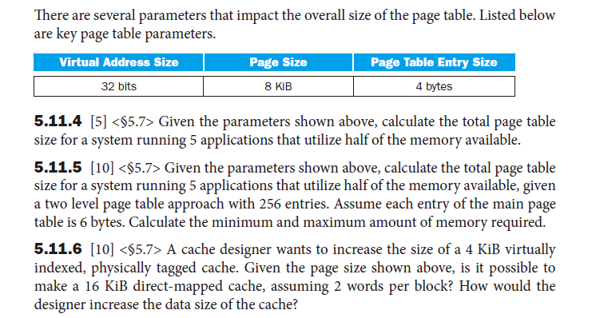

Slide 32
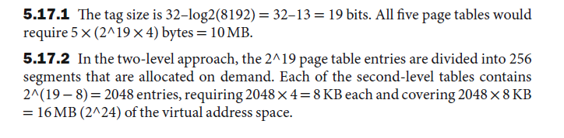
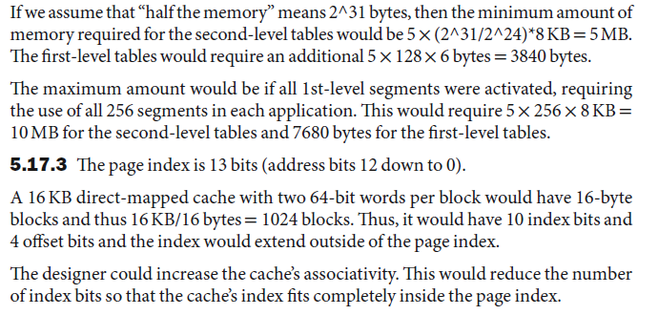

Slide 33
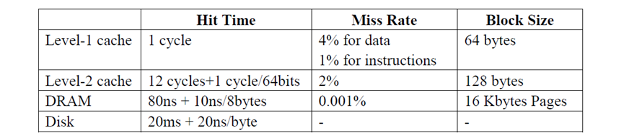
HW10
Problem1
Assume you have a 1GHz processor with 2-level of cache, DRAM main memory, and a hard disk for virtual memory. The first level cache is split for instructions and data. The L1 (level-1) cache is virtually addressed and physically tagged. The memory system has the following parameters.
The system includes a TLB with a miss rate of 0.1% for data. It never misses for instructions. The TLB miss penalty is 40 cycles. TLB hits take place in parallel with level-1 cache.
AMAT = hitrateL1 * accessTimeL1 + MissRateL1(hitrateL2(accessTimeL1 + accessTimeL2)+ missrateL2(accessTimeL1 + accessTimeL2 + accesstimeMainmemory))
= accessTimeL1 + MissRayeL1*accessTimeL2

Slide 34
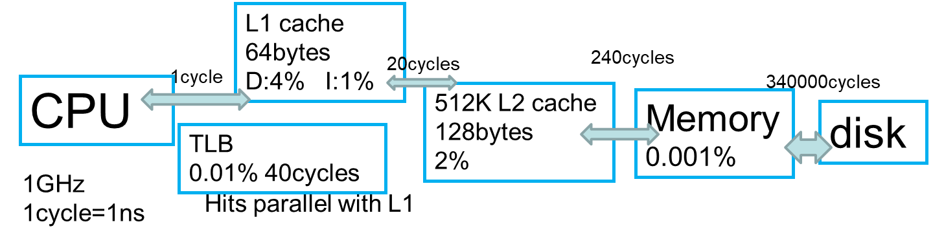
HW10
AMAT = hitrateL1 * accessTimeL1 + MissRateL1(hitrateL2(accessTimeL1 + accessTimeL2)+ missrateL2(accessTimeL1 + accessTimeL2 + Average TimeMemory))
Average Time L1 = accessTimeL1 + MissRateL1*Average TimeL2
Average TimeL2 = accessTimeL2 + MissRateL2*(Average TimeMemory)
Average TimeMemory = accseeTimeMemory + Missrate Memory* (accessTime Disk)

Slide 35
HW10
What is the AMAT (average memory access time) in number of cycles for instruction
access?
b) What is the AMAT in number of cycles for data accesses?
L1 cache
64bytes
D:4% I:1%
20cycles
240cycles
1cycle
20327680cycles
CPU
512K L2 cache
128bytes
2%
Memory
0.001%
disk
TLB
0.01% 40cycles
1GHz
1cycle=1ns
Hits parallel with L1
L1 cache: virtually addressed and physically tagged.
TLB在CPU与L1cache之间，hits可以并行
L1—L2: 12cycles + 64bytes*1cycle/8bytes = 20cycles
L2—DRAM: 80cycles + 10cycles/8bytes*128bytes = 240cycles
DRAM—disk: 20000000cycles + 20cycles/byte*16KB = 20327680cycles

Slide 36
HW10
L1 cache
64bytes
D:4% I:1%
20cycles
240cycles
1cycle
20327680cycles
CPU
512K L2 cache
128bytes
2%
Memory
0.001%
disk
TLB
0.1% 40cycles
1GHz
1cycle=1ns
Hits parallel with L1
L1 cache: virtually addressed and physically tagged.
TLB在CPU与L1cache之间，hits可以并行
Memory: 240+0.001%*20327680 =443.2768 ns
L2: 20 + 2%*443.2768 = 28.8655 ns
The system includes a TLB with a miss rate of 0.1% for data. It never misses for instructions.
TLB是虚拟地址和物理地址的转换表
Inst: 1 + 1%*28.8655 = 1.2886 ns
Data: 0.999*[1+0.04*28.8655] + 0.001*[40+1+0.04*28.8655]= 2.19462 ns

Slide 37
HW10
c) You have now decided to change your L1 cache from virtually indexed, physically tagged to virtually indexed, virtually tagged. What does this change architecturally? What are the new AMAT times for instruction and data?
L1 cache
64bytes
D:4% I:1%
1cycle
20cycles
240cycles
CPU
340000cycles
512K L2 cache
128bytes
2%
Memory
0.001%
disk
TLB
0.1% 40cycles
1GHz
1cycle=1ns
Hits parallel with L1
L1 cache: virtually addressed and virtually tagged.
TLB在L1cache与L2cache之间，hits可以并行

Slide 38
HW10
L1 cache
64bytes
D:4% I:1%
20cycles
240cycles
1cycle
340000cycles
CPU
512K L2 cache
128bytes
2%
Memory
0.001%
disk
TLB
0.1% 40cycles
1GHz
1cycle=1ns
Hits parallel with L1
L1 cache: virtually addressed and virtually tagged.
TLB在L1cache与L2cache之间，hits可以并行
The system includes a TLB with a miss rate of 0.1% for data. It never misses for instructions.
Instruction accesses:全hit，hit时与L1 cache并行，不用TLB时间 不变 1.2886cycles

Slide 39
HW10
L1 cache
64bytes
D:4% I:1%
20cycles
240cycles
CPU
340000cycles
1cycle
512K L2 cache
128bytes
2%
Memory
0.001%
disk
TLB
0.1% 40cycles
1GHz
1cycle=1ns
Hits parallel with L1
L1 cache: virtually addressed and virtually tagged.
TLB在L1cache与L2cache之间，hits可以并行
Data accesses: TLB是虚拟地址和物理地址的转换表，L1 virtually tagged
0.96*1+0.999*[0.04*0.98*(20+1)+0.04*0.02*(1-0.001%)*(240+20+1)+ 0.04*0.02*0.001%*(20327680+240+20+1)] + 0.04*0.1%*[0.98*(20+40+1)+0.02*(1-0.001%)*(240+40+20+1)+0.02*0.001%*(20327680+240+40+20+1)]
A – L2 time
A = [0.98*(20+1)+0.02*(1-0.001%)*(240+20+1)+
0.02*0.001%*(20327680+240+20+1)] = 29.865536 ns
Data : 0.96*1 + 0.04*(0.999*A+0.001*(40+A)) = 2.156 ns

Slide 40
HW10
Cache
Virtually-Indexed, Virtually-Tagged
Virtually-Indexed, Physically-Tagged
Physically-Indexed, Physically-Tagged
需要将CPU发出的虚拟地址转换位物理地址。

Slide 41
HW11
Problem 2
An important advantage of interrupts over polling is the ability of the processor to perform other tasks while waiting for communication from an I/O device. Suppose that a 2GHz processor needs to read 1000 bytes of data from a particular I/O device. The I/O device supplies 1 bytes of data every 0.01ms. The code to process the data and store it in a buffer takes 2000 cycles.
If the processor detects that a byte of data is ready through polling, and a polling iteration takes 40 cycles, how many cycles does the entire operation take?
b. If instead, the processor is interrupted when a byte is ready, and the processor
spends the time between interrupts on another task, how many cycles of this other
task can
2000cycles 针对的是 1000 bytes 的数据。

Slide 42
HW11
(a) 假定处理器在轮询下一个byte前会处理数据，处理器的频率为2GHz，I/O 每0.01ms 提供一个byte，即一个byte需要的时间为：
0.01ms*2GHz=20000cycles
而处理一个byte的时间则为2000/1000=2cycles，可忽略，一个polling iteration 的时间为40cycles，所以0.01ms，共
200000/40=500 polls
检测一个新的byte，需要一整个polling iteration，所以1个byte 需要500*40=20000cycles
总共1000byte，需要20000*1000=20000000 cycles = 2*10⁷ cycles
每个2000cycles：20000-2000=18000cycles用于polling。每一个byte：18000/40=450pollings。每一个byte：450*40+2000=20000cycles。总共：20000*1000=20000000cycles
(b) 每一次处理器需要100cycles来处理中断，因此对于1byte来说有
0.01ms*2GHz-100cycles=19900 cycles 来处理其他任务
对于1000 bytes 有19900*1000=19900000 cycles for other task

Slide 43
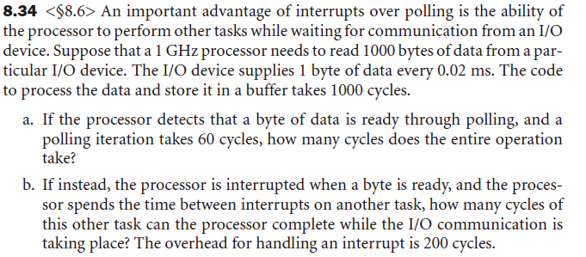

Slide 44
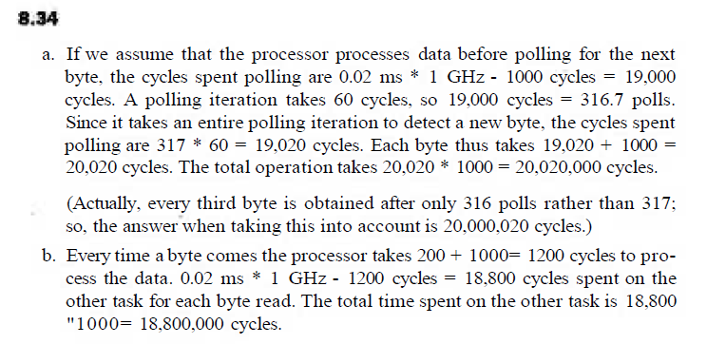

Slide 45
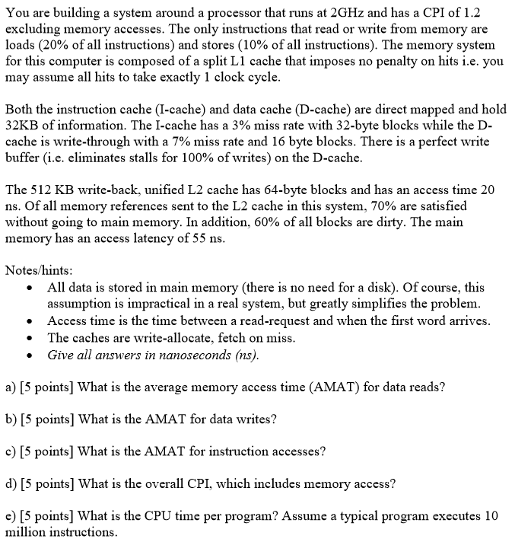
HW12
Problem 1

Slide 46
HW12
Problem 1
a)
AMAT _{dataread} = HitTime_{L1} + MissRate_{L1}(AMAT_{L2})
AMAT _{L2} = HitTime_{L2} + MissRate_{L2}[MemAccessTime+ DirtyRate_{L2}(MemAccessTime)]
= 20 ns + 0.3[55ns + 0.6(55ns)] = 46.4ns
AMAT _{dataread} = HitTime_{L1} + MissRate_{L1}(AMAT_{L2}) =0.5ns + 0.07(46.4ns) = 3.748ns
b)
The L1 cache implements write-through using a perfect write-through buffer. With the perfect write-through buffer, there will be no stall when CPU writes data.
Both data read and data write miss rate are 5% in the D-cache, so
AMAT _{datawrite} = AMAT_{dataread} = 3.748ns

Slide 47
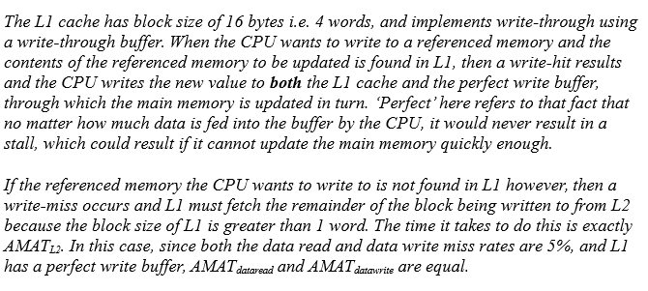
HW12

Slide 48
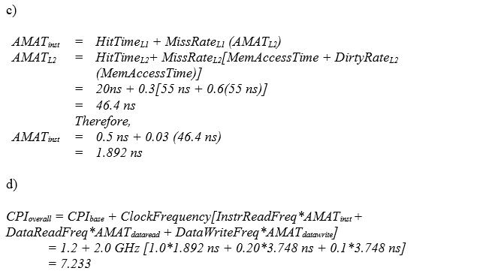
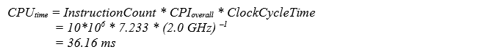
HW12
Problem 1
c) AMAT _{ins} = HitTime_{L1} + MissRate_{L1}(AMAT_{L2})
=0.5ns + 0.03(46.4ns) = 1.892ns
d)
e)

Slide 49
HW13
Problem 2
In this exercise, we will examine space/time optimizations for page tables. The following table shows parameters of a virtual memory system.
For a single level page table, how many page table entries (PTEs) are
needed? How much physical memory is needed for storing the page
table?
2) Using a multilevel page table can reduce the physical memory
consumption of page tables, by only keeping active PTEs in physical
memory. How many levels of page tables will be needed in this case?
And how many memory references are needed for address translation if
missing in TLB?
3) An inverted page table can be used to further optimize space and time.
How many PTEs are needed to store the page table? Assuming a hash
table implementation, what are the common case and worst case numbers
of memory references needed for servicing a TLB miss?

Slide 50
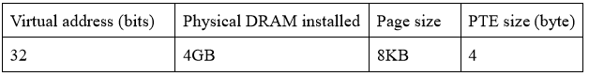
HW13
Problem 2
因为page size=8KB=2^13 bytes，即13bits，页内偏移是13bits，则虚拟页号占：32-13=19bits所以有2^19 or 512KB entries
由于 PTE size=4byte ，所以 physical memory =4byte*512KB=2MB
2. 因为：page size=8KB or 13bits 而page table entry size=4byte
所以索引：index=2^13/2^2=2^11 一层page table 只能包含 2^11个PTE，每个PTE对应下一级
page table
而因为有2^19 entries 所以至少需要两级索引 (11 + 11 > 19)，至少需要2次内存访问。
反置页表是根据主存中物理页号来组织的，页表的容量是主存中的物理页数：因为DRAM的
大小为4GB=2^32 byte or 32bits
而page的大小为8KB or 13bits
所以PTE有4GB/8KB=2^19 =512K entries
Common case : 没有hash冲突，一个主存参考地址对应一个地址转换
Worst case: 有hash冲突，最坏的情况下，512K的主存参考都要查找

Slide 51
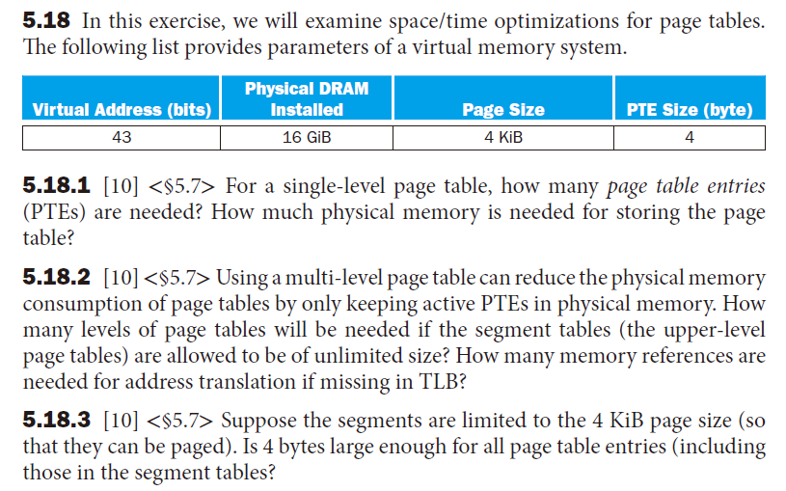
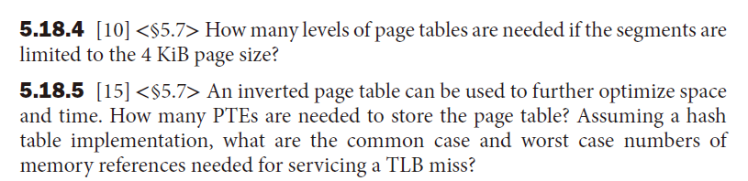

Slide 52
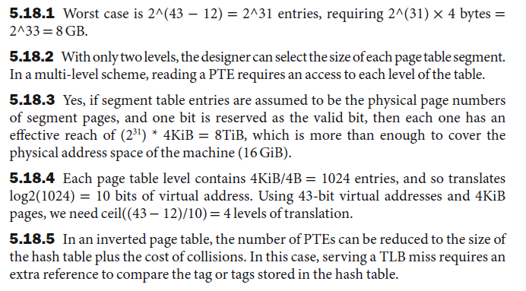

Slide 53
随堂小测1
Problem 1
Below is the C code for the strcpy function. The strcpy copies string y to string x.
void strcpy (char x[ ] , char y[ ])
{
int i;
i = 0;
while ((x[i] = y[i]) != ‘\0’) /* copy & test byte */
i += 1;
}
And then following is a translation to RISC-V assembly language. Assume that base addresses of string x and y are stored separately in x10 and x11, while i is stored in x19. Please fill in the blanks to complete the code.
string x首地址 – x10 string y首地址 - x11 i - x19
String x 和 string y都存储在存储器里。

Slide 54
随堂小测1
Problem 1
sp
x19
-4
strcpy:
addi sp, sp, -4 // adjust stack, push 1 word in stack
sw x19, 0(sp) // save x19
add x19, x0, x0 // i = 0
L1:
add x5, x19, x11 // address of y[i] in x5
lw x6, 0(x5) // x6 = y[i]
add x7, x19, x10 // address of x[i] in x7
1.___________ // x[i] = y[i]
beq x6, x0, L2 // go to L2 if x[i] == ‘\0’
2.___________ // i = i + 1
3.___________ // go to L1
L2:
4.___________ // restore old x19
5.___________ // adjust stack, pop 1 word off stack
jal x0, Return // return
sp
sw x19, 0(sp)
sw 存储一个word 4bytes
sp = sp - 4
sw x6 0(x7) (4pt)
addi x19, x19, 1 (4pt)
jal x0, L1 (4pt)
lw x19, 0(sp) (4pt)
addi sp, sp,4 (4pt)

Slide 55
随堂小测1
Problem 2
Assume the following latencies for logic blocks in the datapath, and the processor is non-pipelined. Regs take longer than Control. Add (pc+4) is not included in the critical path.
What is the clock cycle time if the only types of instructions we need to support are ALU instructions (ADD, AND, etc.). (5pt)
What is the clock cycle time if we only had to support LW instructions? (5pt)
What is the clock cycle time if we only had to support SW instructions? (5pt)
What is the clock cycle time if we must support ADD, BEQ, LW and SW instructions? (5pt)

Slide 56
随堂小测1
Problem 2
单周期的CPU会在一个时钟周期内完成一条指令，既从指令取出，到得到结果，全部在一个时钟之内完成。
流水线CPU是多周期的，将整个CPU的执行过程分成几个阶段，每个阶段用一个时钟去完成。
单周期CPU one cycle
IF | ID | EX | MEM | WB
流水线CPU
one cycle
one cycle
one cycle
one cycle
one cycle

Slide 57
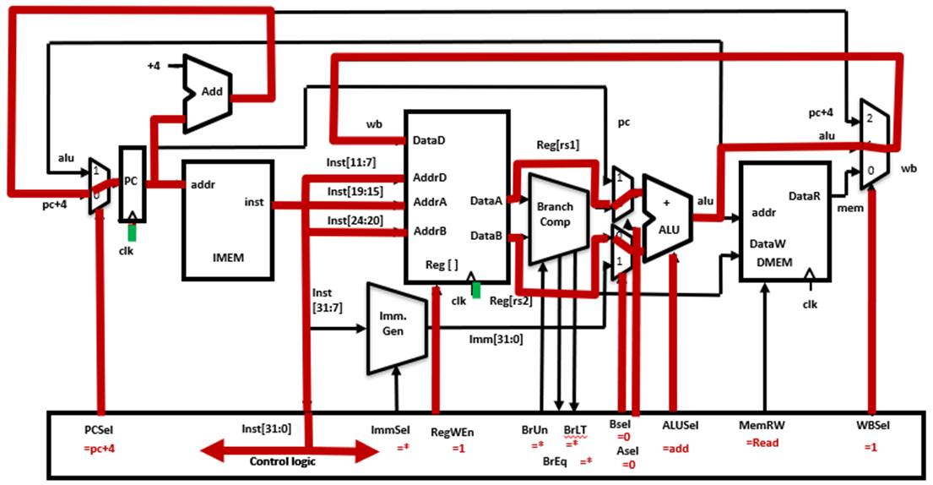
随堂小测1
Problem 2
a) 对于ALU指令（ADD, AND等）需要：
I-Mem->Regs->ALUmux->ALU->Mux->Regs
所以时钟周期：
500 (I-Mem) + 220 (Reg. Read) + 60 (Mux) + 180 (ALU) + 60 (Mux) + 220 (Reg. Write) = 1240 ps
这里，add（pc+4）不算在关键路径中。

Slide 58
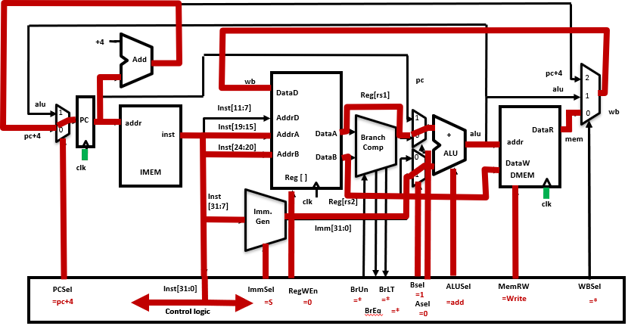
随堂小测1
Problem 2
b) 对于指令LW，其需要符号扩展和数据存储器访问，其长路径为：
I-Mem -> Regs -> ALUmux -> ALU -> D-mem -> Mux -> Regs
符号扩展延迟小于寄存器延迟
所以关键路径时延：
500ps(I-Mem) + 220ps( Reg.read) + 60ps(ALUmux) + 180ps(ALU) + 500ps(D-mem) + 60ps(Mux) + 220ps(Reg.write) = 1740 ps

Slide 59
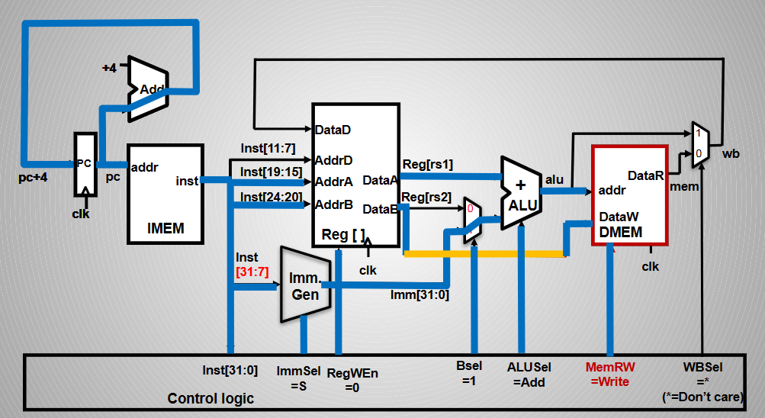
随堂小测1
Problem 2
c) SW 指令最长延迟路径为：I-Mem, Regs, Mux, ALU, D-Mem,
所以关键路径时延：
500ps(I-Mem) + 220ps( Reg.read) + 60ps(ALUmux) + 180ps(ALU) + 500ps(D-Mem)
= 1460 ps

Slide 60
随堂小测1
Problem 2
d) 要求支持 ADD,BEQ, LW, and SW 指令，这里我们需要“最慢”的指令(LW) 1740ps

Slide 61
随堂小测1
Problem 3
In this exercise we examine in detail how an instruction is executed in a single-cycle datapath. The the processor execute the following instruction:
addi x1, x2, 15
Assume that data memory is all zeros and that the processor’s registers have the following values at the beginning of the cycle in which the above instruction word is fetched:
X0 X1 X2 X3 X4 X5
0 5 -5 -3 2 10
a) The final value in x1 is ____. (4pt) a) x1 = x2 + 15 = -5 +15 = 10
b) What is the ImmSel (I, S, B, *)? (3pt) b) I-type, I
c) What are the outputs of the immediate generator for this instruction? c) 15
d) What is the ALU’s function for this instruction (add, sub, or, and)? d) add
e) What is the WBSel (0 or 1 or 2)? (2pt)
f) What is the PCSel (0 or 1)? (2pt)
g) For the ALU, ___, ___ are the data input values (please write the number). g) -5, 15

Slide 62
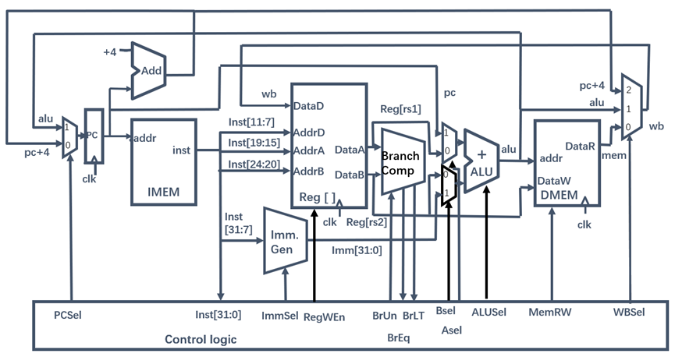
随堂小测1
Problem 3
addi x1, x2, 15
e) What is the WBSel (0 or 1 or 2)? (2pt) e) 需要将alu的结果写回寄存器x1, WBSel = 1
f) What is the PCSel (0 or 1)? (2pt) f) 地址没有跳转，PCSel = 0 (pc+4)
g) For the ALU, ___, ___ are the data input values (please write the number).
g) -5, 15

Slide 63
随堂小测1
Problem 4
Assume a 16-bit architecture, with word-addressed memory. The load operations are following (given as word address, data and addresses are used decimal representation):
Reading 0 from addr 8
Reading 128 from addr 14
Reading 32 from addr 12
Reading 256 from addr 5
Reading 64 from addr 9
Reading 100 from addr 7
The direct-mapped cache contains 4 entries with block size of 4 bytes (one word).
Assuming cache is vacant at the beginning. The result of the first and second load operation “ Reading 0 from addr 8, Reading 128 from addr 14” is below.
Index 2 bits, offset 2bits
Tag 16-2-2 = 12bits
Valid | Tag | Data
1 | 2 | 0
0
1 | 3 | 128
0

Slide 64
随堂小测1
Problem 4
Reading 0 from addr 8
Reading 128 from addr 14
Reading 32 from addr 12
Reading 256 from addr 5
Reading 64 from addr 9
Reading 100 from addr 7
Valid (1pts) | Tag (2pts) | Data (2pts)
1 | 3 | 32
1 | 2 | 64
1 | 3 | 128
1 | 1 | 100
The 0 entry
The 1 entry
The 2 entry
The 3 entry
Tag index offset
8: 0000 10 00 00 (the 0 entry, tag 2)
14: 0000 11 10 00 (the 2 entry, tag 3)
12: 0000 11 00 00 (the 0 entry, tag 3)
5: 0000 01 01 00 (the 1 entry, tag 1)
9: 0000 10 01 00 (the 1 entry, tag 2)
7: 0000 01 11 00 (the 3 entry, tag 1)
We can make byte address mod 16(index + entry 4bits) to determine the entry.
Or make word address mod 4 to determine the entry.
8 mod 4 = 0, 14 mod 4 = 2, 12 mod 4 = 0, 5 mod 4 = 1, 9 mod 4 = 1, 7 mod 4 = 3

Slide 65
随堂小测1
Problem 5
Consider a computer with an 8-bit address space and a 2-way 64-byte data cache containing 8-byte cache blocks.
1. How many blocks does the cache have? (3pt)
8
The direct-mapped cache has 64 bytes data, and the block is 8-byte, thus the cache has 8 blocks, (64 bytes / 8 bytes = 8).
2.The Tag filed in address needs _ bits. (3pt)
3
The block is 8-byte, thus the Offset field needs 3 bits (2^3 = 8). The 2-way cache has 8 blocks, thus the cache has 4 sets. Index field needs 2 bits (2^2 = 4).
The Tag filed needs 3 bits (8 – 2 – 3 = 3).

Slide 66

随堂小测1
Problem 5
3. The table below shows a trace of addresses((given as byte address) accessed by the processor. Assume the cache is initially empty and use LRU replacement. For each access, please indicate whether it hits or misses (H/M). (14pt)
Hex Address | Binary Address | Hit/Miss
00 | 000 0 0 000 | M
20 | 001 0 0 000 | M
06 | 000 0 0 110 | H
85 | 100 0 0 101 | M
07 | 000 0 0 111 | H
F1 | 111 1 0 001 | M
33 | 001 1 0 011 | M
F0 | 111 1 0 000 | H
21 | 001 0 0 001 | M
set | Tag | Tag
Set0 | 000 | 001
Set1
Set2
set3
Offset
3bits
Index
2bits
Tag
5bits
100
001
111
001
Hex Address: 06
Tag index
000 00
Hex Address: 07
Tag index
000 00
Hex Address: 85
Tag index
100 00
Hex Address:21
Tag index
001 00
Hex Address:F0
Tag index
111 10
Hex Address: F1
Tag index
111 10
Hex Address:33
Tag index
001 10

Slide 67

Project1
project1
设计单周期CPU控制器电路图，采用组合逻辑电路的方式，自己选择芯片并完成电路图设计，用Altium Designer (AD) 软件绘制电路图。

Slide 68
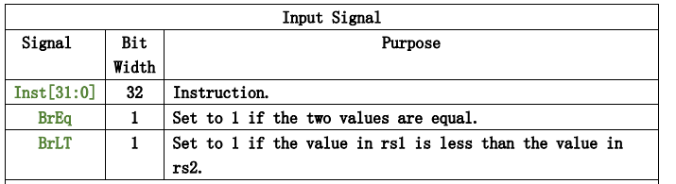
Project1
project1
1. 确定 control logic 的输入信号和输出信号

Slide 69
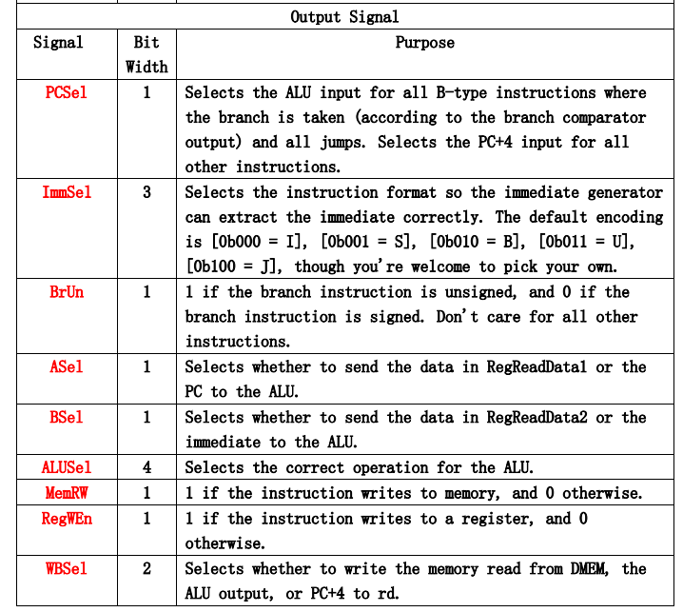
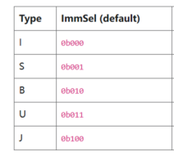
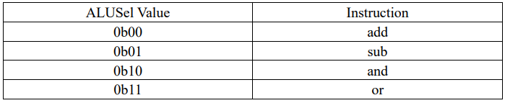
Project1
project1
1. 确定 control logic 的输入信号和输出信号

Slide 70
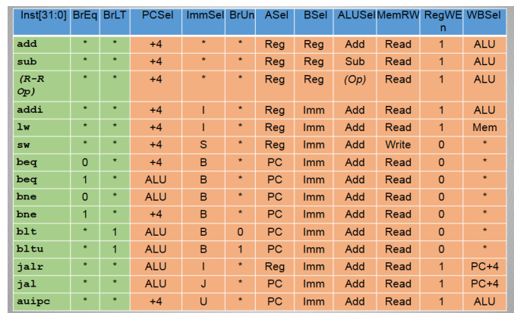
Project1
project1
2. 确定 control logic 的输出信号表达式
可以根据指令作用绘制真值表，依据真值表写出输出信号的表达式。
PCSel | 0 |  | 1
 | +4 |  | ALU
ASel | 0 |  | 1
 | Reg |  | PC
BSel | 0 |  | 1
 | Reg |  | Imm
RegWEn | 0 |  | 1
 | ottherwise |  | Write to a register
MemRW | 0 |  | 1
 | Read |  | Write
WBSel | 00 | 01 | 10 | 11
 | DMEM | ALU | PC+4

Slide 71
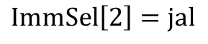
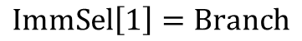
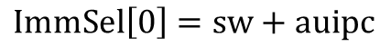
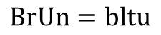
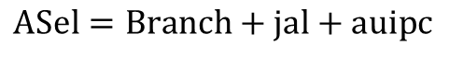





Project1
project1
2. 输出信号的表达式。

Slide 72

Project1
project1
3. 电路图构建思路
3.1 根据 inst[31:0] 中的opcode, funct3, funct7域 确定指令。
根据Opcode 确定指令所属类型。Opcode = inst[6:0]
教材p119 SB-type Opcode有误，应为 1100011
方法1， 根据 opcode各位确定所属指令类型。
由于各指令类型Opcode后两位都是1，不考虑。

Slide 73
Project1
project1
方法2， 根据不同指令类型的Opcode特点，
进行对Opcode分类。
ADDI
LW
AUIPC
Opcode[6]Opcode[5]=00 D0
R-type
SW
Opcode[6]Opcode[5]=01 D1
译码器
D0
D1
D2
D3
JALR
JAL
SB-type
Y0
Y1
Y2
Y3
Opcode[6]Opcode[5]=11 D3
Opcode[5]
A
B
Opcode[6]
根据 Opcode[4]Opcode[3]Opcode[2]来细分

Slide 74
Project1
project1
SB-type
LW
SW
根据 Opcode[4]Opcode[3]Opcode[2]来细分
Opcode[4:2]= 000 E0
译码器
JALR
Opcode[4:2] = 001 E1
Y0
Y1
Y2
Y3
Y4
Y5
Y6
Y7
E0
E1
E2
E3
E4
E5
E6
E7
Opcode[2]
Opcode[3]
Opcode[4]
A
B
C
JAL
Opcode[4:2] = 011 E3
R-type
ADDI
Opcode[4:2] = 100 E4
AUIPC
Opcode[4:2] = 101 E5
SB-type = D3 E0
R- type = D1 E4

Slide 75




Project1
project1
3.2 根据Opcode确定指令类型后，根据 funct3和funct7确定具体指令。
以R-type 和 SB-type为例。
译码器
Y0
Y1
Y2
Y3
Y4
Y5
Y6
Y7
F0
F1
F2
F3
F4
F5
F6
F7
R-type | Funct7 Inst[31:25] | Funct3 Inst[14:12]
Add | 7’b0000000 | 3’b000
Sub | 7’b0100000 | 3’b000
Or | 7’b0000000 | 3’b110
And | 7’b0000000 | 3’b111
Funct3[0]
Funct3[1]
Funct3[2]
A
B
C

Slide 76




Project1
project1
3.2 根据Opcode确定指令类型后，根据 funct3和funct7确定具体指令。
以R-type 和 SB-type为例。
译码器
SB-type | Funct3 Inst[14:12]
Beq | 3’b000
Bne | 3’b001
Blt | 3’b100
Bltu | 3’b110
Y0
Y1
Y2
Y3
Y4
Y5
Y6
Y7
F0
F1
F2
F3
F4
F5
F6
F7
Funct3[0]
Funct3[1]
Funct3[2]
A
B
C

Slide 77

Project1
project1
And
3.4 根据指令以及输入信号确定输出信号。
beq
Or
BrEq
bne
PCSel
blt
bltu
BrLT
jalr
jal

Slide 78



Project1
project1
4 选用芯片。
3线-8线 译码器 74HC138
输出反相

Slide 79

Project1
project1
4 选用芯片。
3线-8线 译码器 74HC138
参数

Slide 80



Project1
project1
4 选用芯片。
4路与非门 CD4011

Slide 81


Project1
project1
4 选用芯片。
4路与非门 CD4011

Slide 82

Project1
project1
5 绘制电路图，根据上述分析，将输入信号，译码器，与非门，或非门，输出信号相连。
1.注意信号连线。防止信号线复杂可以分部分绘制，比如上述的指令类型，具体指令电路和最后的输出电路。
2.注意信号名称，同一信号的信号名称应一致。
2.注意各芯片的电源电压，如果芯片电源电压不一致，需要增加另一电源电压。
在报告中说明选用的电源电压是多少。
3.注意各芯片名称， 不同芯片名称应不同。

Slide 83

Project1
project1

Slide 84

Project2
project2
任务1：仿真器拓展，完成以下R-type指令，并自行设计一条指令实现优化。

Slide 85


Project2
project2
任务1：仿真器拓展，完成以下R-type指令，并自行设计一条指令实现优化。
1.instforms:指令编码。
仿真器在 instforms.hpp 文件中针对不同指令类型构建了用于编码和译码的结构体，你需要在 instforms.cpp 中实现对应的编码函数。

Slide 86


Project2
project2
任务1：仿真器拓展，完成以下R-type指令，并自行设计一条指令实现优化。
2. decode: 指令译码
主要关注从 decode.cpp 文件 1368 行 开始的 decode 函数，输入一条指令 inst，需要给出其对于的操作数 op 和指令条目InstEntry。需要参照 cube 及其他
指令格式，在 InstEntry.cpp 和 InstId.hpp 中添加其他四条拓展指令内容，注
意及时修改 InstId.hpp 中 maxId 的值。
在 InstId.hpp 中声明，cube 指令声明于 634 行
cube 指令， InstEntry.cpp 中3891 行

Slide 87


Project2
project2
任务1：仿真器拓展，完成以下R-type指令，并自行设计一条指令实现优化。
2. decode: 指令译码
cube 指令的译码已于 decode.cpp 文件1839 行给出，你需要参照 cube 及其他指令格式，在 decode.cpp 中添加其他四条拓展指令译码内容。
根据拓展指令的funct3，编写相应代码。

Slide 88

Project2
project2
任务1：仿真器拓展，完成以下R-type指令，并自行设计一条指令实现优化。
3. Hart: 指令执行
关注从 Hart.cpp 文件 979行开始的内容，即指令的执行过程。根据这些示例，你需要完成其他四条拓展指令的执行过程，同时注意左移操作时寄存器中数据的比特位长度应设为 32 位，可使用强制类型转换为int。
op0 对应目的寄存器 rd，op1 和 op2 对应源寄存器 rs1 和 rs2。执行过程中从 op1 对应寄存器中读出相应内容并立方计算， 然后将结果写回 op0 对应寄存器中。

Slide 89

Project2
project2
任务1：仿真器拓展，完成以下R-type指令，并自行设计一条指令实现优化。
3. Hart: 指令执行

Slide 90



Project2
project2
任务1：仿真器拓展，完成以下R-type指令，并自行设计一条指令实现优化。
3. Hart: 指令执行
在完成执行函数后，你需要参照 cube 指令在 Hart.cpp 文件 5442 行开始的
execute()函数中添加拓展指令的 label 以及相应的跳转执行，cube 指令的
label 已 于 6007 行给出，执行跳转已于 6171 行给出。
Hart.hpp 文件中 1848 行起已添加拓展执行函数的声明。自行设计的指令需要添加声明。

Slide 91

Project2
project2
任务2：优化SM3加密算法。
利用拓展指令 rotleft、rotright、reverse、notand，对照 sm3.c 修改 sm3.s 汇编文件，将原来汇编文件中的部分指令等价转换为拓展指令。
实验重点关注sm3_str_summ()函数。

Slide 92







Project2
project2
任务2：优化SM3加密算法。
在sm3.c文件中找到用到拓展指令的代码，找到相应C代码在sm3.s中的汇编代码，用优化汇编代替原来汇编。
a5 = (a5 << 19) | (a5 >> (32 – 19))
a5 = (a5 << 9) | (a5 >> (32 – 23))
a5 = (a5 >> 7) | (a5 << (32 – 7))

Slide 93

Project2
project2
任务2：优化SM3加密算法。
汇编文件修改完成后，可以使用 vscode 的 debug 选项逐行调试代码，运行 结束后终端会输出程序执行过程中的指令条目数“Retired XXX instructions in X s”。
在对比过程中， 你需要分别输入”Zhejiang University”、 ”COD”、 你的学号， 计算其哈希值，在验证你汇编的正确性同时比较优化效果。
自定义指令优化思路：
可以在sim3.s中找到多次重复的指令片段，将其改为一条指令，并用优化汇编。

Slide 94
谢谢大家！

